Slide 1

Final defense on Industrial II project
Hawassa University
Institute of Technology , Faculty of Informatics
Department of Computer Science

Slide 2
Topic: Cuisine Management System for HU- IoT Campus
Advisor: Ms. Turufat Tesfaye
Group Members :
Betelhem W/Michael
Ebise Gutema
Fadima Mohammed
Hawi Belete
Sinen Abebe

Slide 3
Introduction
Developed to modernize campus food services.
Enables students to view menus, place orders, and give feedback.
Helps staff manage meals, stock, and daily operations.
Replaces slow, manual processes with a fast and user-friendly digital platform.
Improves communication and reduces food waste.

Slide 4



Project Evolution: From Concept to Completion
Previous Semester
Web food ordering system for students
Dashboard for lounge staff and admins
React, Redux, Node.js, MySQL planned
Examiner Feedback
Payment
Add proper security(hash)
Localization
This Semester: Full System Development
Implemented all planned features
User login, menu, ordering
Role-based dashboards
Feedback and reports
Improved UI, security, navigation, validation

Slide 5
Technologies & System Architecture
Technologies Used
System Architecture Overview
Frontend: ReactJS + Bootstrap
Client Side: React UI for user interaction
State Management: Redux
Server Side: Express API for logic
Backend: Node.js + Express
Database: MySQL stores all data
Database: MySQL
Communication: Axios via RESTful APIs
API Communication: Axios (RESTful)
Security: Role-based access with middleware
Security: JWT, bcrypt, .env configs
Deployment Ready: Render, Vercel, Railway

Slide 6
Defined User Roles
Student
Lounge Staff
View menus
Manage menu items
Place orders
View incoming orders
Submit feedback
Track prepaid users
Admin
Manage users and lounges
Access system-wide reports
Monitor feedback
Each role features distinct permissions and a customized dashboard for secure, tailored access.

Slide 7
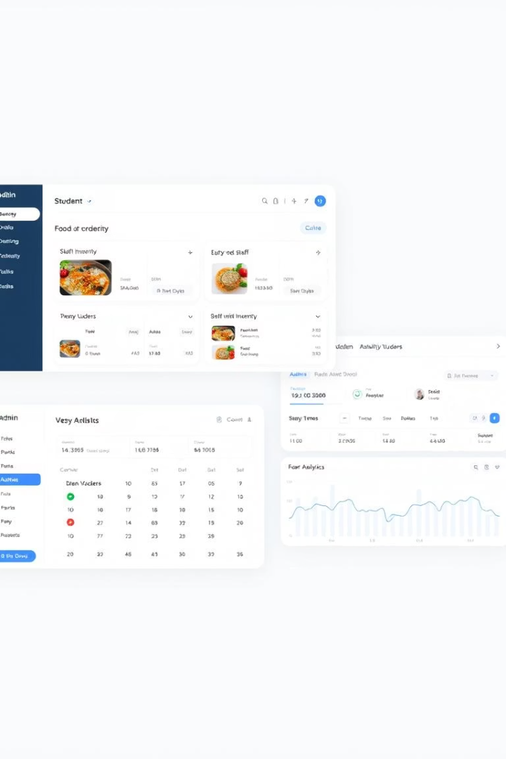



Key Features by Role
Student Dashboard
Lounge Staff Dashboard
Admin Dashboard
Login & Auth
Manage menu items
Manage lounges
View lounge menus
Manage all users
Process incoming orders
View overall system reports
Add to cart, place orders
Manage prepaid users
Monitor lounges, analytics
View order history
Submit feedback
Access sales reports
Access full feedback history
Respond to feedback

Slide 8



Implementation Methods
Development Process
Incremental coding
Test-Driven Development (TDD)
Pair programming & code reviews
Deployment Strategies
Pilot phase
Phased rollout
Optional parallel run
System Integration
React & Node.js via REST APIs
MySQL with role-based access
Render, Vercel, Railway ready

Slide 9
System Integration & Flow
How Components Work Together:
Student logs in and interacts via React UI
Data is sent to the backend using Axios (API)
Express server handles logic and routes requests
Server fetches or stores data in MySQL
Responses are sent back to frontend and displayed to the user
️ Security & Access:
JWT tokens stored in cookies
Middleware checks roles before allowing access
All data flow is controlled and validated

Slide 10

Clean & Consistent Code Practices
Naming Conventions
Consistent naming for frontend, backend, and database elements.
Folder/File Structure
Lowercase-with-hyphens (e.g., order-page.jsx).
React Components
PascalCase (e.g., OrderPage.jsx).
Variables/Functions
camelCase (e.g., handleLogin()).

Slide 11




API Design, Error Handling & Security
RESTful API
Security
Error Handling
Standard structure: POST /api/menus/
GET /api/orders/.
Routes secured with authenticateToken and authorizeRoles.
try/catch blocks in backend.
Password Security
Hashed with bcrypt.

Slide 12








Database Structure & Relationships
MySQL Used
Naming Convention
Normalized tables for efficiency.
snake_case for tables/columns.
Foreign Keys
Primary Keys
Ensure orders to users and menu_items to lounges relationships.
Always end with _id.

Slide 13
Coding Workflow & Deployment Readiness
Feature Testing
Tested with Postman, MySQL Workbench, and Browser.
Collaborative
Used Pair Programming and code reviews.
Connectivity
Frontend & Backend connected via Axios.

Slide 14
Testing Objectives & Core Modules
Ensured the system is bug-free and meets all requirements.
Manual testingdone both for frontend and backend
Focused on these key areas:.
User Authentication
1
Login/logout functionality.
2
Menu Management
Item creation and updates.
Order Processing
3
Cart and order flow.
4
Feedback Submission
Collection and display.
Admin Functions
5
Management tools.
6
Database & API connectivity

Slide 15

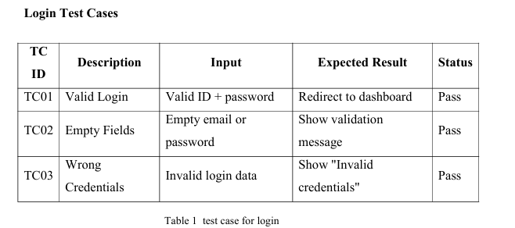



Test Case Design
D
Login Tests
Valid, empty fields, wrong credentials.
Order Tests
Add to cart, submit order, empty cart.
Lounge Staff
Add/edit menu items.
Feedback & Reports
Submit feedback, view analytics.
Designed with valid & invalid inputs to simulate real user actions. Each test passed successfully.

Slide 16
Testing Types & Tools Used
Unit Testing: Tested individual components (e.g., LoginPage, Cart)
Integration Testing: Verified frontend ↔ backend using Postman & MySQL
System Testing: Simulated real user sessions (admin/student)
Acceptance Testing: Reviewed by team before submission
Tools: Chrome, Postman, MySQL Workbench, localhost

Slide 17




Error Handling & Validation Results
Our application robustly handles various errors to ensure a smooth user experience and system stability. All critical errors are managed with try/catch blocks and middleware.
API Failure
Handled gracefully with user-friendly 404 messages for unavailable resources.
Form Errors
Alerts appear for empty or invalid fields, guiding users to correct their input.
Authentication
Unauthorized access attempts result in a 401 response, requiring proper tokens.
Authorization
Users attempting administrative routes without permission are denied with a 403.

Slide 18






Why Security Matters in Our System
Security is paramount to protect sensitive user data and maintain system integrity. It builds trust and prevents unauthorized access or data breaches. Our approach spans both database and system levels.
System Integrity
Ensures reliability and user trust.
Access Control
Prevents unauthorized entry and data leaks.
Data Protection
Secures user data and financial transactions.

Slide 19





Database-Level Security Measures
We implement stringent measures to secure our database, from access control to data encryption and backup strategies.
RBAC
Role-based access control for student, staff, and admin roles.
Password Hashing
All passwords encrypted with bcrypt for strong security.
SQL Injection Protection
Parameterized queries prevent malicious SQL injection attacks.
Sensitive Data Encryption
Payment and other sensitive information are securely encrypted.
Daily Backups
Automated daily backups ensure data recovery in case of failure.

Slide 20
API Security & Session Management
Our API security is built on robust authentication and session management, safeguarding against common web vulnerabilities.
JWT Authentication
HTTP-only Cookies
Auto Logout
Only verified users can access APIs using JSON Web Tokens.
Tokens are stored in HTTP-only cookies, hidden from JavaScript.
Sessions automatically expire after a period of user inactivity.
CORS Policies
Rate Limiting
Strict CORS policies block unauthorized frontend access to APIs.
Implemented to prevent brute-force attacks and service spamming.

Slide 21
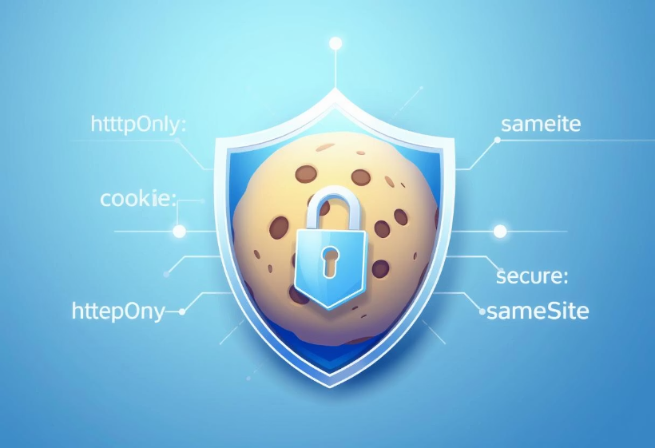
Secure Cookies & XSS Protection
Cookie security flags and robust input validation are critical for preventing cross-site scripting (XSS) and cross-site request forgery (CSRF) attacks.
Cookie Flags Set
httpOnly: true - Prevents client-side script access.
secure: true - Ensures cookies are sent only over HTTPS.
sameSite: 'Strict' - Blocks cross-site request forgery (CSRF).
XSS Protection
Inputs are rigorously validated on both frontend and backend.
Sanitization prevents malicious script injection.

Slide 22








Middleware & General Safety Features
Our system employs comprehensive middleware and general safety features to ensure robust security across all interactions. These layers are critical for preventing unauthorized access and data exposure.
Middleware
Generic Errors
Checks authentication and roles on every route request.
Error messages are generic to avoid leaking sensitive system information.
HTTPS/TLS
Input Validation
HTTPS deployment with TLS encryption is planned for secure communication.
Validation is enforced on both frontend and backend for data integrity.

Slide 23




Current Deployment & Structure
The system is fully functional in the local development environment, utilizing a modern tech stack for both frontend and backend.
Frontend
Backend
Database
Built with React and Bootstrap, running at http://localhost:5173.
Powered by Node.js and Express, accessible at http://localhost:5000.
MySQL serves as the robust relational database for data storage.
Communication
Frontend and backend connect seamlessly via Axios requests.

Slide 24


Ready for Production Hosting
The application is prepared for seamless transition to production, with distinct strategies for frontend, backend, and database deployment.
Frontend Build
1
Utilize npm run build for optimized production assets. Host on Apache or Nginx for efficient delivery.
Backend Deployment
Deploy the Node.js Express application to a compatible server environment.
Database Migration
Move the MySQL database to a secure cloud or institutional server for robust hosting.
Secure Configuration
4
Use .env.production for environment-specific configurations and ensure middleware, bcrypt, and CORS remain active.

Slide 25




System Modification Strategy
Mobile App
Android/iOS app for better accessibility. Reach users on the go.
Loyalty Program
Reward system to engage frequent users. Boost customer retention.
Live Tracking
Real-time order tracking with wait times. Enhance user transparency.
Food Recommendations
Automated suggestions based on order history. Personalize user experience.

Slide 26
Backup and Recovery Strategy
MySQL Database Backup
Daily backups using mysqldump. Ensures data integrity.
Dual Storage
Backups stored online (cloud) and offline (external storage). Redundancy is key.
System Restore
In case of failure, use mysql < backup.sql. Quick recovery.
One-Click Backup
Admins can initiate backups from dashboard. User-friendly.
Project Code Backup
Two backup methods were used:
GitHub: Best for version control and easy recovery using git clone.
Manual: The entire project folder zipped and saved on cloud/USB.

Slide 27



Server Crash & Disaster Recovery
Reinstall Core
Reinstall Node.js and MySQL. Foundation for recovery.
Code Recovery
2
Recover code using GitHub (git clone). Restore project files.
Database Restore
Restore database from backup.sql. Critical data retrieved.
System Restart
Start system with npm install and npm start. Bring services online.

Slide 28




Conclusion
Full-Stack Web App
User Benefits
Admin Tools
Students easily view menus, order food, and give feedback.
Lounge staff and admins manage menus, payments, track orders.
Tech Stack
System successfully built as a full-stack web application.
ReactJS + Redux, Node.js + Express, MySQL.
Solved major manual issues like long queues, menu confusion, and no order tracking.
Improved convenience, speed, and transparency for everyone. We delivered a powerful solution.

Slide 29
Thank You

